Slide 1
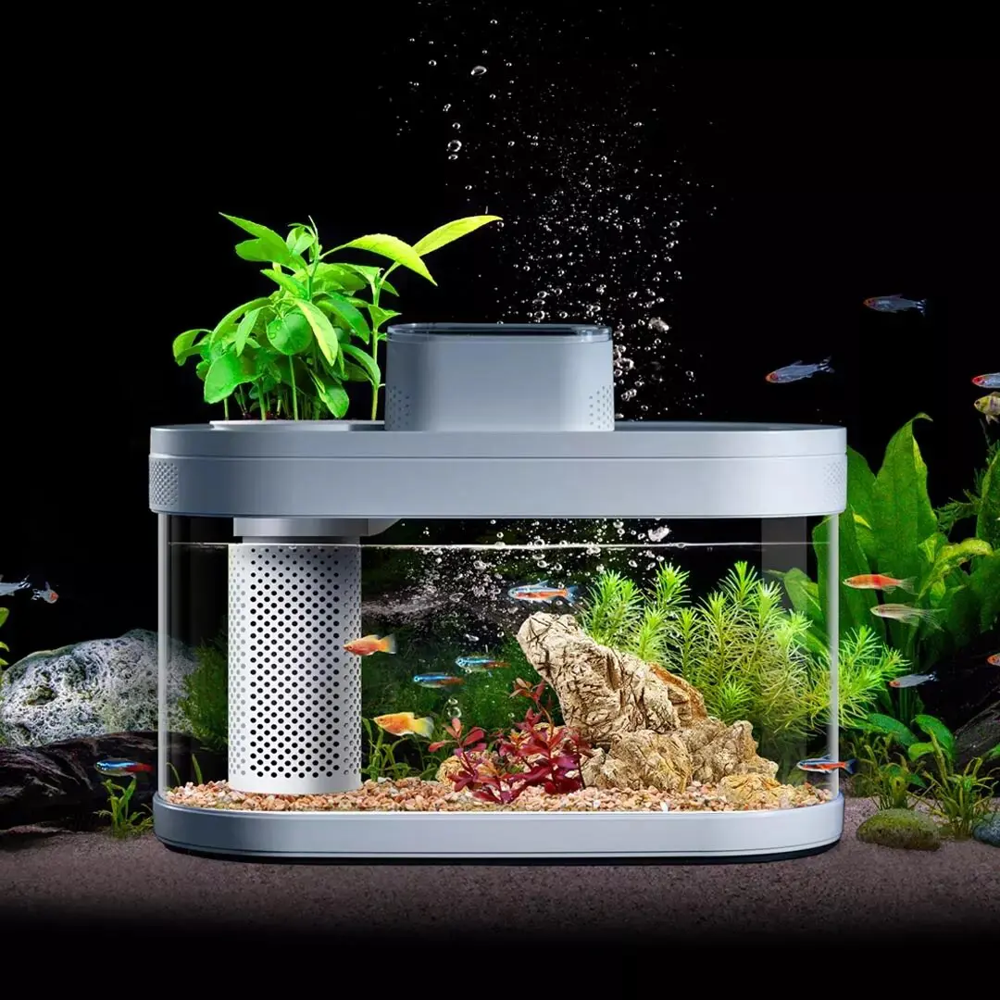
PEP_30
Smart Aquarium using IOT

Slide 2
Introduction
Problem Specification
Aquarium Management Current State,
• is dependent on manual monitoring and instruction.
• unable to automate and monitor in real-time.
• Common techniques for fish farming include regulating
temperature, controlling lighting, monitoring water
quality, and providing the appropriate amount of food.
• results in dangers to the environment, failure, and reliability.

Slide 3
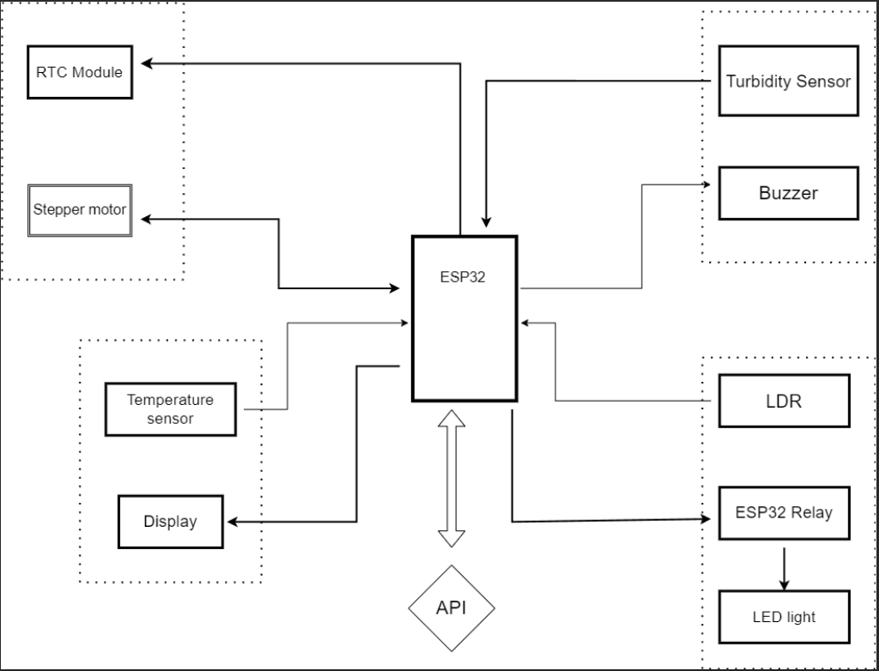
System Diagram

Slide 4
Key Benefits
Automated processes to make maintenance easy.
Simple remote control and monitoring.
Integrating IoT devices with simple.
Set up applications to make things easier.
Planned resource use to lower costs.
Improved user experience to increase satisfaction.

Slide 5
Objectives
Main Objective
The creation and use of a modern Internet of Things (IoT) Smart Aquarium system would transform aquarium management by providing the best conditions for aquatic life using smart monitoring and control systems.
Sub-Objectives
Use IoT devices for real-time control and monitoring functions.
User-friendly controls may increase the user experience.
Automate service tasks and simplify feeding schedules.
Promote the health and safety of marine life by keeping ideal conditions.
Build the system the best solution in the industry.

Slide 6
Procedures
Displaying Temperature Values
R.M.D.E.Rajapaksha
Start
If the temp is detected
No
Yes
Display the temperature
End

Slide 7
Displaying warnings for Water Quality Issues.
(S.A.H.D.M.Perera)
Start
Water detection using Turbidity Sensor
Normal or Mud Mixed
Normal
Mud Mixed
Warning Alarm
End

Slide 8
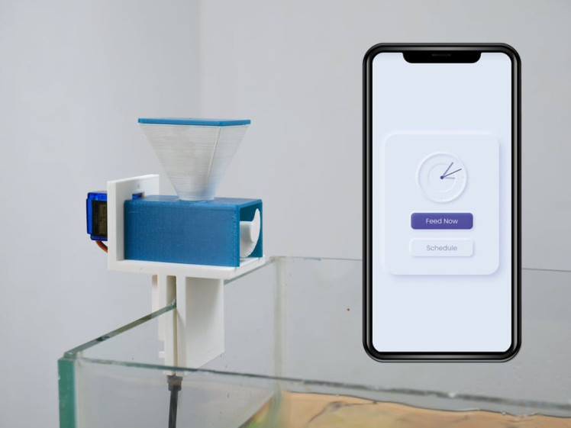
Providing the required amount of food to the fish
Connect the RTC module to the Arduino board.
Connect the stepper motor to the Arduino board.
Assemble the fish food container with the stepper motor to dispense food.
(R.A.T.R.Lakshitha)

Slide 9
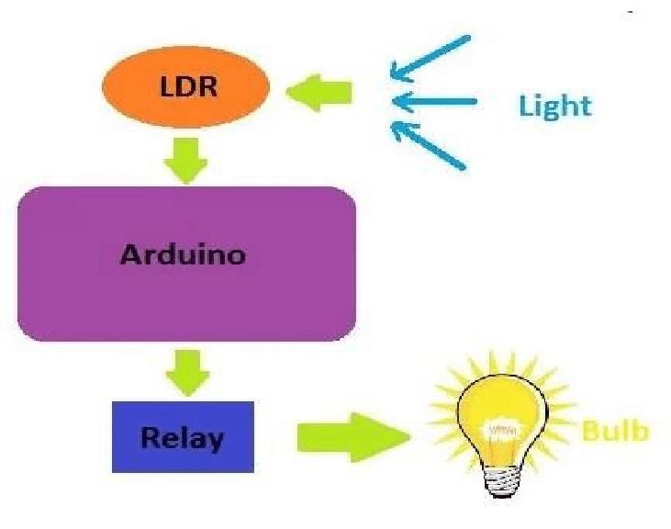
Managing the light using LDR
Managing light using LDR involves primarily using the LDR sensor along with other equipment for this function.
Why?
Light in Dark Environment
LDR Sensor Sensitivity
How?
LED strips are connected to the LDR sensor to regulate lighting.
(A.J.M.S.Sithumini)

Slide 10
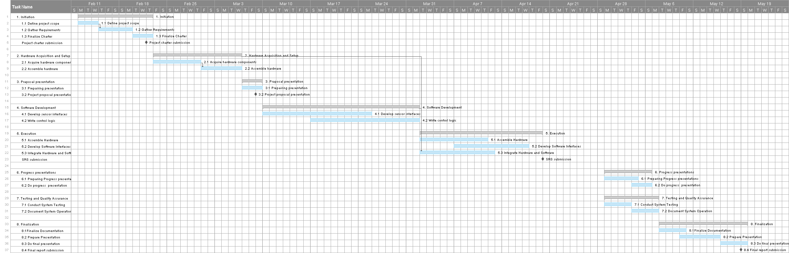
Gantt Chart

Slide 11
Personnel and Facilities
Student Name and IT Number | Function Name | Role | Facilities
R.A.T.R. Lakshitha (IT22617514) | Feed Measurement and Dispensing | Team Leader Project Manager Hardware Engineer | IoT Devices, Programming Tools, Documentation Tools
S.A.H.D.M. Perera (IT22911858) | Water Quality Monitoring | Hardware Engineer IoT Specialist | Water Quality Analysis Tools, Programming Tools
R.M.D.E. Rajapaksha (IT22339188) | Temperature Monitoring | Software Developer Business Analyst | Sensors, IoT Devices, Calibration Tools, Hardware Components
SITHUMINI A.J.M. S (IT22329974) | Night Light Control | Software Developer Project Designer | Programming Tools, Aquarium Environment Setup

Slide 12
Hardware Requirements
ESP-32S V1 Development Board
16*4 LCD
12C module for LCD
LDR sensor module
18B20 Waterproof temperature sensor
Turbidity Sensor
RTC Module DS3231
Stepper motor
Empty fish feeder tank
9V 6F22 Battery
LM2596 DC-DC Buck Converter
ESP8266 Wi-Fi Relay Module
LED bulbs
Dot board
Aquarium tank
Software Requirements
Arduino IDE
Arduino Libraries
Programming Languages (C/C++)
Operating System (Windows)
Network Connectivity (Wi-Fi network for connecting the ESP8266 Wi-Fi Relay Module to the internet)
Optional Simulation or Debugging Tools

Slide 13
Other Requirements
Power Supply : Adequate power source.
Enclosure : Secure housing for components.
Mounting Hardware : Screws, brackets, etc.
Internet Connectivity : For remote monitoring/control.
Data Storage : SD cards, cloud storage, etc.
User Interface : Buttons, switches, touchscreen.
Documentation : User manuals, guides.
Safety : Insulation, grounding, compliance.
Testing Equipment : Multimeters, oscilloscopes.
Maintenance : Updates, replacements, support.

Slide 14
Budget
Components | Price
ESP-32S V1 Development Board | LKR 1,900.00
16*4 LCD display | LKR 1,640.00
12C module for LCD | LKR 460.00
LDR sensor module | LKR 170.00
18B20 Waterproof temperature sensor | LKR 340.00
Turbidity Sensor | LKR 3,400.00
RTC Module DS3231 | LKR 715.00
Stepper motor | LKR 2,400.00
empty fish feeder tank | LKR 2,500.00
9V 6F22 Battery | LKR 800.00
LM2596 DC-DC Buck Converter | LKR 1,600.00
ESP8266 Wi-Fi Relay Module | LKR 450.00
LED bulbs | LKR 250.00
Dot board | LKR 1,160.00
Aquarium tank | LKR 1,500.00
Total | LKR 19,285.00

Slide 15
Thank you

